Slide 1
West County Fire Control
6852 Meadville Road – PO Box 5
Girard, PA 16417-0005
Station KNBD551
(1961 – 2011)

Slide 2
Disclaimer
After more than fifty years of service to the citizens of Erie County, the West Erie County Emergency Communication Center ceased to operate as a public safety dispatch center on the first of December, 2011. The initial purpose of this website is to commemorate the service that West County provided to the community in those fifty years.
The domains http://westcountyfire.com/ and http://westcountyfire.net/ are privately owned by Micheal H. McCabe and any editorial content found here is solely the personal opinion of Mr. McCabe.
Needless to say, there is nothing “official” about this website and the views and opinions expressed here do not represent the views of the West Erie County Emergency Communication Center, Incorporated or any of the municipal governments that own that fine 501 (c) (3) corporation.

Slide 3
Radio Frequencies & Call Signs
Fire Dispatch (KNBD551): 33.980 MHz (Simplex), Carrier Squelch
Fire Ground Operations (East): 33.960 MHz
Fire Ground Operations (West): 33.880 MHz
Fire Police & EMS Operations: 33.940 MHz
Police Dispatch (KGD591): 155.130 MHz (Simplex)
Girard Borough & Girard Twp. Road Crews (KDR726): 155.715 MHz (Simplex)
Lake City Sewer Authority (WNRM624): 155.760 MHz
Med Channels 1-10 (KNNN703)

Slide 4
Public Access Phone Numbers
911 (Girard): Basic 911 service from 1983 forward serving Girard, Lake City, and Platea Areas.
911 (Albion): Basic 911 service from 1989 forward serving Albion, Cranesville, and Springfield.
774–4331: Old seven-digit fire line for Girard, Lake City, and Platea.
756–3131: Old seven-digit fire line for Albion, Cranesville, and Springfield
774-2651: Seven-Digit police line for Girard and Lake City.
774-2652: Alternate seven-digit police line for Girard and Lake City.
774-0254: Originally a “secret” number for the unrecorded line. Later used for facsimile.
1-800-722-3392: Original WATTS line for West County. In service from 1993 to appx. 1999.
1-877-836-9908: WATTS line used from 1999 to

Slide 5
Agencies:
A.F. Dobler Hose & Ladder Co.
Albion Fire Dept.
Cranesville Vol. Fire Dept.
Edinboro Fire Dept.
Fairview Fire Dept.
Franklin Twp. Fire Dept
Lake City Fire Co.
McKean Hose Co.
Platea Fire Co.
Springfield Fire Dept
West County Paramedic Assoc.
Central Erie Co. Paramedic Assoc.
Albion Police Dept.
Girard Police Dept.
Lake City Police Dept.

Slide 6
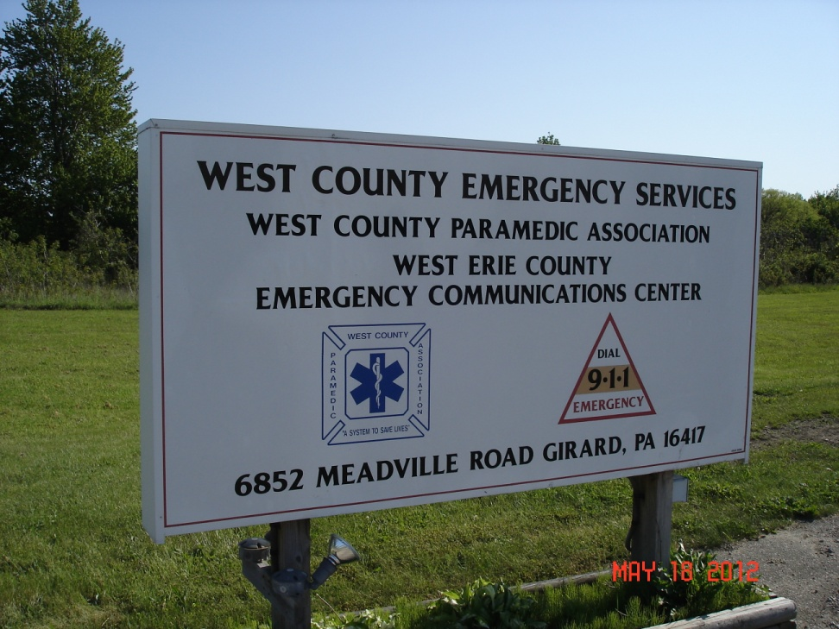
West Erie County Emergency Communication Center, Inc.
From 1993 until closure at the end of 2011, West County Fire Control was located at 6852 Meadville Road, Girard.
The “comm center” was co-located with the West County Paramedic Association.

Slide 7
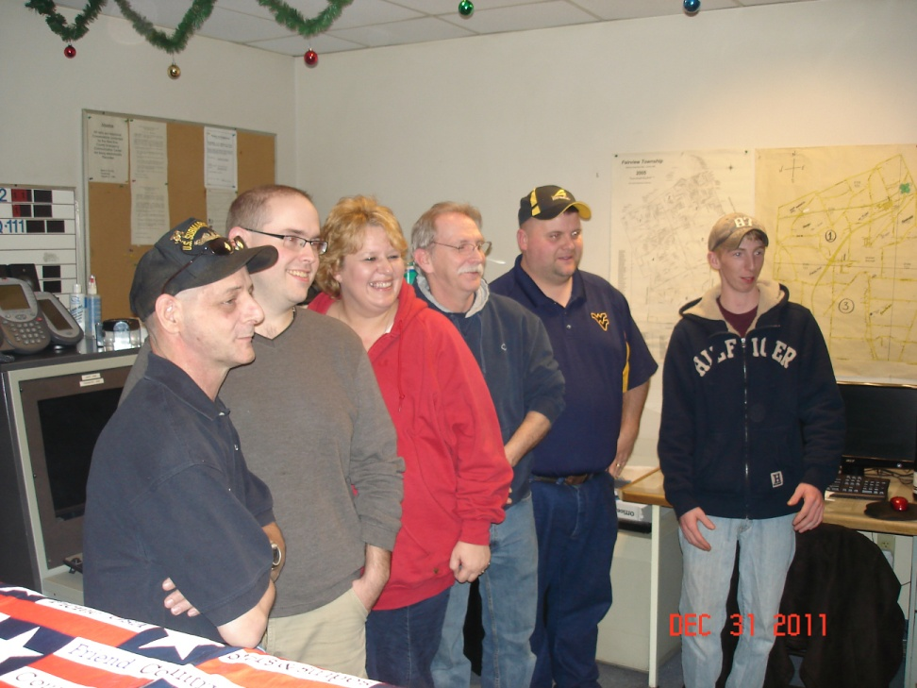
Dispatchers on Dec. 31, 2011
Dave Chaffee (Far Left)
Matt Fuller
Leigh George
Mark Schultz (Supervisor)
Steve Smith
Branden Schultz (Far Right)
Gail Edwards (Absent)
Jennifer Waxham (Absent)
John Durlin (Absent)

Slide 8
Partial List of Former Dispatchers
(Please submit names of other dispatchers to admin@westcountyfire.com)
Liz Howard (Schultz)
Diana Sumner
Gail Clapper
Matt Kemling
Micheal McCabe
Carol Summerville
Paul Neuman
Diana Pavolko
Jennifer Pavolko
Heather Ericsson
Jon Weber
Rick Adams
Ed Podpora
Paul Douglas
Bob Gould
Don Bovaird
Many others!
West County had frequent, rapid, and unpredictable employee turnover due to constant micromanagement by the board of directors.
Fire Dept. Politics were a major factor in employee tenure.
Many terminations were due to “personality conflict” between dispatchers and agency employees.
This stabilized somewhat after 1993 when APCO Training was mandated for employment.
Getting fired from West County was a badge of honor for many firefighters, police officers, and paramedics!

Slide 9
A Brief History
“West County Fire Control” went into operation on September 1, 1961 when automatic telephone switching replaced human operators in the Albion (756 exchange) and West Springfield (922 exchange) telephone service areas. The first communication center was located at the 6-90 Truck Stop in West Springfield. In 1975, West County merged with Girard Fire Control and moved operations to the Borough of Girard – first at the municipal power plant on Mechanic Street and later (1981) in the municipal building on Main Street West.
West County began offering basic 911 service to telephone customers in the Girard area (774 exchange) in 1983 – a full ten years before Erie County Government got into the act. Basic 911 service to Albion and Springfield was enabled in 1989 when Alltel upgraded the telephone switching systems in those communities. Enhanced 911 followed in 1993 when West County merged with Edinboro Fire Control. This merger required the construction of the current communication center on Route 18 in Girard Township. Later, West County assumed dispatch duties for the McKean and Fairview areas when Millcreek Fire Control stopped using the VHF low-band radio system. At its peak in 2009, West County provided emergency services to slightly less than half the land area in Erie County – extending west from the Waterford Township Line to the Ohio State Line and South from the Lake Erie Shoreline to the Crawford County Line.
In those fifty years of service, there were literally scores of operators working behind the console – answering emergency calls and directing the response of police officers, firefighters, and emergency medical workers. I can only name a recent few, but would like to personally thank Mark Schultz, Gail Edwards, Leigh George, Steve Smith, Dave Chaffee, Matt Fuller, Branden Schultz, Jennifer Waxham, and John Durlin for continuing the difficult work of keeping West County on the air in its final days. I’ll miss hearing your voices on the radio and the personalized service that only a small agency can offer.
The arguments over the wisdom of putting all the county’s communication assets in one location under the control of a single, poorly funded, agency have been made and lost. Reason, logic and experience have failed to convince our short-sighted elected officials that redundancy in a complex and fragile electronic communication system is an advantage; particularly when lives are on the line. County government has been penny-wise and pound-foolish, but blame must also be distributed to the municipal governments and local agencies that chose to believe that Erie County 911 would offer comparable service at “no cost” to the taxpayers. Newsflash: There is no free lunch.

Slide 10

“Routine Emergencies:” 1961 to 2011
No emergency call is ever “routine”, but for fifty years, the operators at West County handled calls for emergencies of all types: crimes, fires, medical emergencies, and rescues.
Just exactly what constitutes an emergency is often a matter of personal opinion – many callers would emphasize that “this really isn’t an emergency” when reporting their own heart attack or stroke.
Other, less stoic individuals would demand an immediate, “Code 3” response for such trivial matters as a missing newspaper, strange lights in the sky, or the mythical “barking duck.”
Some callers became notorious for their propensity to see things like flying saucers, bigfoot, and the mysterious apes of Mechanic Street.

Slide 11
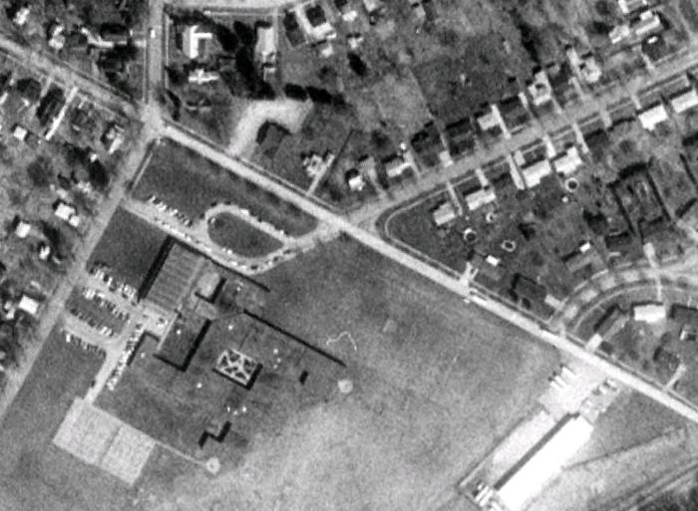
September 18, 1977 –
F2 Tornado Damages School and Homes in Lake City
During the early evening hours of September 19, 1977 an F2 tornado touched down just west of Lake City, PA. After heavily damaged Elk Valley Elementary school, the tornado traveled east along Martin Avenue, destroying homes and injuring seven persons.
At the time of the tornado, several sporting events were underway in the ball-fields immediately adjacent to the schools. Concerned parents from all over Erie County converged on the scene, complicating traffic and rescue efforts.
Operators at West County Fire Control dealt with widespread telephone outages and communication failures in an era before cell-phones and maintained communication with police, fire, EMS and emergency management officials despite terribly overloaded voice radio channels.

Slide 12
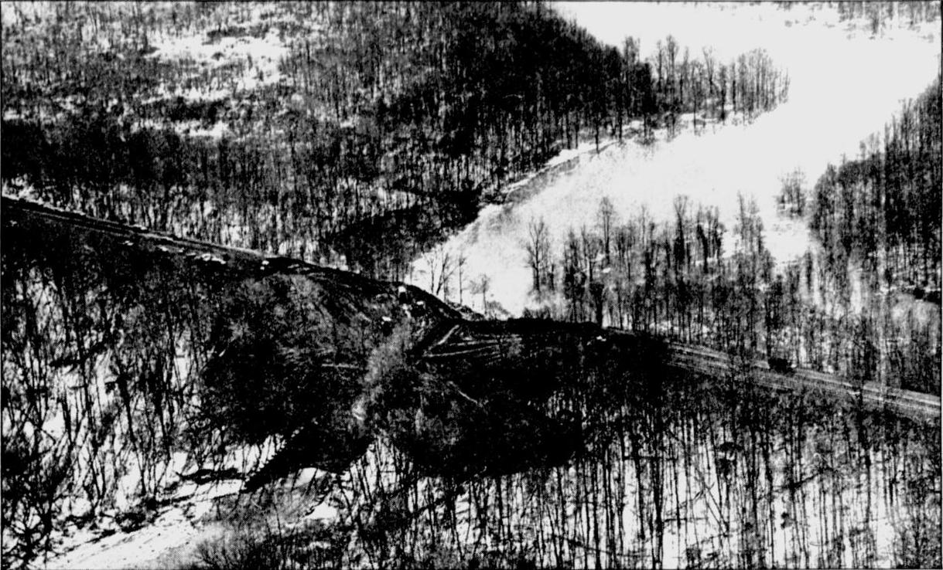
March 18, 1985 – Culvert Collapse Dams Elk Creek at Conrail Tracks
The collapse of a stone culvert carrying the Conrail mainline over Elk Creek created an accidental dam that impounded the swiftly flowing waters of Elk Creek, creating a 70 acre lake that inundated homes south of the tracks and threatened those north of the tracks with a flash flood. Excavation crews from Conrail, Great Lakes Construction Co, and the Army Corps of Engineers worked frantically to clear the debris of the culvert and a 100 foot tall mound of earth that formed the dam. Other crews cleared the stream-bed north of the tracks and reinforced the banks to prevent the destruction of West Lake Road and homes located at the mouth of Elk Creek. Despite their efforts, at least one mobile home was “flushed” through the culvert and downstream, creating a striking visual that served in the opening teaser of “Action News 24” for several years afterward.

Slide 13
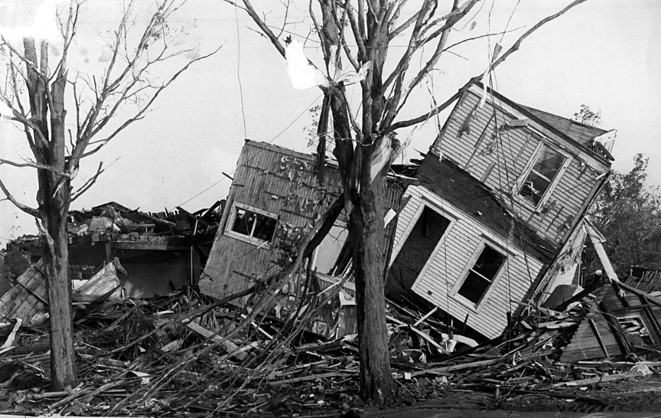
May 31, 1985 Tornado Outbreak – Albion & Cranesville
One disaster that would forever influence the operation of the communications center was the F4 tornado that devastated Albion and Cranesville on May 31, 1985.
At around 5:00 pm, the tornado touched down in extreme northwestern Crawford County near the Ohio State Line. It moved northeast into Erie County, destroying rural farms and homes near the village of Pennside before striking Albion ‘dead center.’ The tornado leveled ten square blocks of Albion Borough, destroying 309 structures and immediately claiming nine lives. It continued northeast unabated into Cranesville where it took another three lives at Kennedy’s Mobile Home Park and destroyed dozens of homes. An additional 82 persons were injured requiring one of the largest rescue responses in the history of Erie County.
These rescues were largely coordinated by the heroic operators at West County Fire Control in Girard.

Slide 14
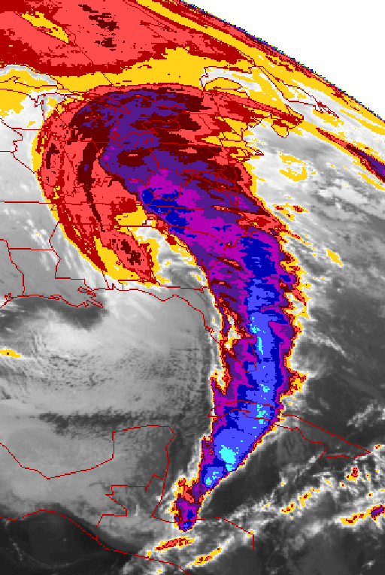
The Snowstorm of the Century – March 13, 1993
One of the first tests of the “new” communication center on Route 18 was the snowstorm of March 1993.
The storm originated in the North Atlantic Ocean on March 8 and meandered across the Caribbean, picking up tropical moisture before joining the Gulf Stream and moving north along the Atlantic Coast.
Striking Pennsylvania on Saturday, March 13, it brought temperatures of -12 (F) in Erie County along with Hurricane Force Winds and snowfalls more than 24” in a 24 hour period. Total accumulation in West County was between 24” and 36” with some drifts reaching twenty feet in height. Widespread power outages, traffic accidents, and road closures tested the emergency services in West County, but the storm claimed no lives – largely due to the diligence and tenacity of the operators at West County Fire Control.

Slide 15
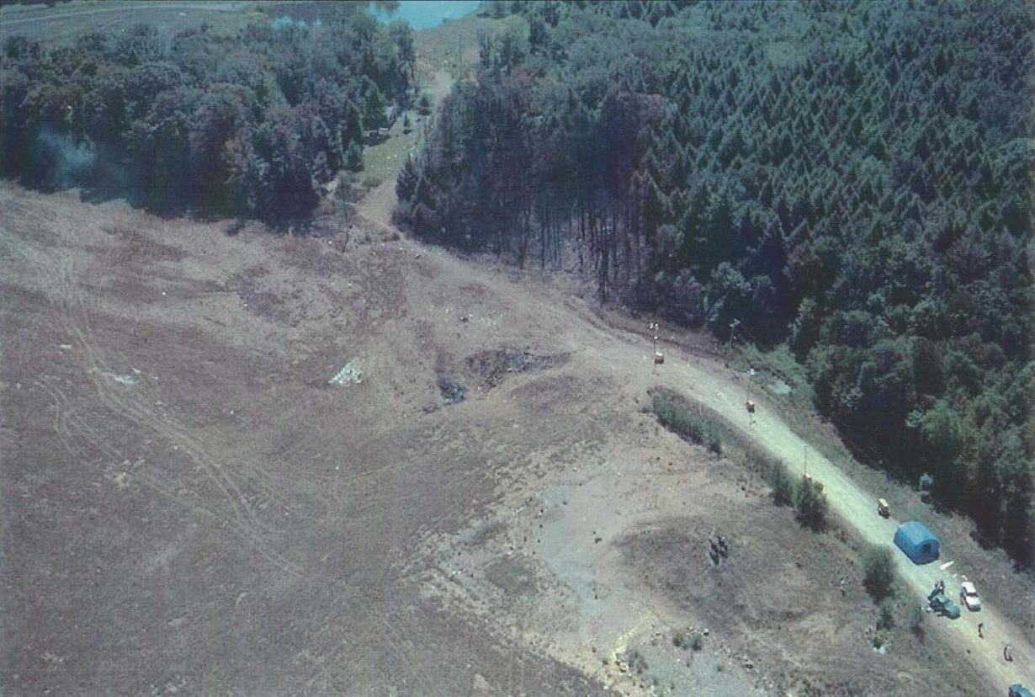
September 11, 2001 – United Airlines Flight 93
By 9:28 AM, nearly everyone with a radio, television, or Internet connection was aware that two passenger jets had crashed into the World Trade Center in New York. Within another few minutes, a third airliner would crash into the Pentagon in Washington, DC. At West County, already busy due to the opening of the Albion Fair, there was another reason for concern: Cleveland Center had just reported that ANOTHER airliner had been hijacked while traveling through Pennsylvania Airspace. United 93 was flying westbound over central Pennsylvania and would cross the Ohio line just south of Mercer County before making a sweeping 180 degree turn near Cleveland and returning to Pennsylvania near Pittsburgh before crashing near Shanksville, PA during a passenger revolt.
At West County, a flurry of electronic messages from NCIC, NLETS, and CLEAN kept the dispatchers busy relaying information to local law enforcement and emergency management officials.

Slide 16

The Last Broadcast & Sign-Off

